Slide 1

DEPARTMENT OF COMPUTER SCIENCE, IT AND ANIMATION
Project Report
On
“ONLINE EXAMINATION SYSTEM”
Submitted by
Mr. Om Satish Lande (Roll No:-45)
Mr. Shubham Ashok Mandavkar(Roll No:-48)
Mr.Sandip Gajanan Mandavkar (Roll No:-49)
Mr. Abhishek Badrinarayan Sajgane(Roll No:-67)
BCA(Sci.) IV Semester
Academic Year-2022-2023
Guided By
Mr. Ganesh . M. Krishnpakshi
Submitted To
Department of Computer Science, IT and Animation Deogiri College,
Aurangabad 431005.

Slide 2
ACKNOWLEDGEMENT
Many people have contributed in some or the other forms to this project, although our name appears on the cover of this project. We could not have done this Case Study without the assistance or support of each of the following. We thank all of you.
We wish to place on record our deep sense of gratitude towards our project guide Mr. Ganesh M. Krishnapakshi for the constant motivation and valuable help through the project. We also want to express our gratitude towards our Head of the department Dr. S. N. Helambe for his invaluable guidance, insightful advice and continuous encouragement. We also extend our thanks to other faculty members for their co-operation.
We also thank those who have directly as well as indirectly supported us for the completion of this Project.
Thank you.
Mr. Om Satish Lande
Mr. Shubham Ashok Mandavkar
Mr. Sandip Gajanan Mandavkar
Mr. Abhishek Badrinarayan Sajgane

Slide 3
INDEX
SR. NO. | CHAPTER NAME | PAGE NO.
1. | INTRODUCTION TO PROJECT | 1
2. | OBJECTIVE OF THE PROJECT | 2
3. | SCOPE 0F PROJECT | 3
4. | DFD (DATA FLOW DIAGRAM) | 4
5. | ENTITY RELATIONSHIP DIAGRAM (E-R) | 5
6. | DATA DICTIONARY | 6
7. | OUTPUT SCREENSHOT | 8
8. | CONCLUSION | 17
9. | BIBLIOGRAPHY | 18
10. | WEB REFERENCES | 19

Slide 4
1. INTRODUCTION TO PROJECT
Online Examination System is a project that enables online exams for students and teachers.
It is cost-effective and scalable, replacing traditional pen and paper-based exams.
Exams can be taken on desktops, laptops, or mobile devices with a browser.
Instant result generation is available for objective type questions.
The system simplifies exam activities, including defining exam patterns and question banks.
The system saves time and money for both examinees and examiners.
Compared to traditional offline exams, online exams are quicker, easier, and provide immediate results.
The system provides a time limit for completing the exam.

Slide 5
2. OBJECTIVE OF THE PROJECT
Efficiency: Online examination systems save time and resources by automating many manual processes involved in conducting exams.
Accessibility: Students can take exams from any location with an internet connection, making it easier for them to participate in exams.
Security: Online examination systems use advanced security measures to prevent cheating and protect the integrity of the exam.
Instant results: Online examination systems provide instant results to students and allow them to review their performance in real-time.
Cost-effective: Online examination systems are cost-effective compared to traditional exam methods as they reduce the need for paper, printing, and manual labor.

Slide 6
3. SCOPE 0F PROJECT
User Management: Allows students to create accounts, log in, and access their respective dashboards.
Exam Management: Admin can create, schedule, and manage exams, add questions, set time limits, and specify the exam format.
Question Bank: A repository of questions that can be used to create exams. Questions can be added, edited, and categorized for easy retrieval.
Exam Taking: Students can take exams online on the platform, with randomized questions and order to ensure each student gets a unique exam.
Results: The system automatically marks exams and provides immediate feedback, allowing students to review the results, mark manually, and provide feedback.

Slide 7










4. DFD (DATA FLOW DIAGRAM)
Data Flow diagram(0 level)
Online Examination System
Admin
Student
Examination
Data flow diagram (1 level)
Registration
Login
Online Examination System
Fill All About
Education
Srudent
Conduct Online Exam
Fill About Exam
Information
Feedback
Administrator

Slide 8
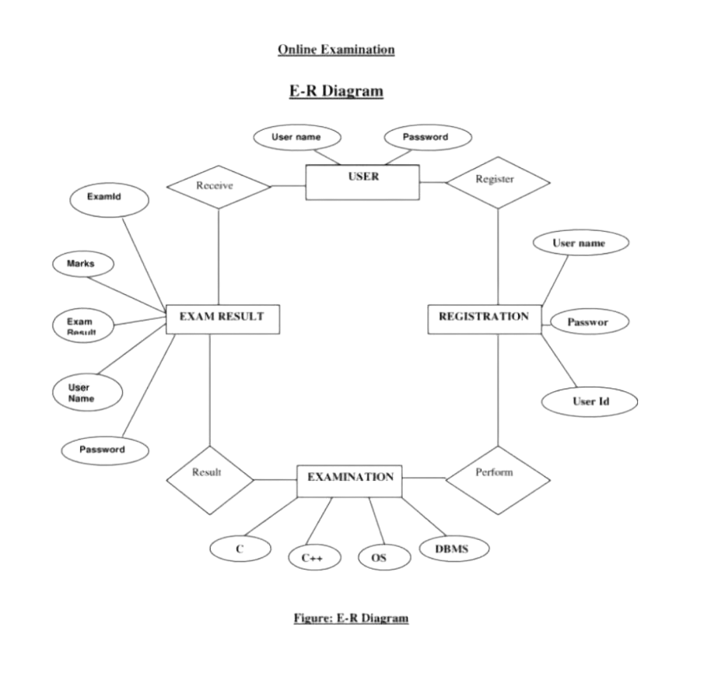
5. ENTITY RELATIONSHIP DIAGRAM (E-R)

Slide 9
6. DATA DICTIONARY
User Reg Table:-
Name | Data Type
ID | INT
NAME | VARCHAR (50)
DOB | DATETIME
GENDER | VARCHAR (10)
BRANCH | VARCHAR (20)
COLLEGE | VARCHAR (50)
UID | VARCHAR (50)
PWD | VARCHAR (20)
RPWD | VARCHAR (20)
UTYPE | VARCHAR (20)
QUE | VARCHAR (500)
ANS | VARCHAR (500)
True/False Based Question Table:-
NAME | TYPE
ID | INT
QUE | VARCHAR(500)
AW | VARCHAR(500)

Slide 10
All Student Marks Table:-
NAME | TYPE
ID | INT
MARKS | INT
Exam Schedule Table:-
NAME | TYPE
ENAME | VARCHAR(30)
EDATE | DATETIME
Option Based Question Table:-
NAME | TYPE
QID | INT
QN | VARCHAR(500)
OPTION 1 | VARCHAR(100)
OPTION 2 | VARCHAR(100)
ANSWER | VARCHAR(100)

Slide 11
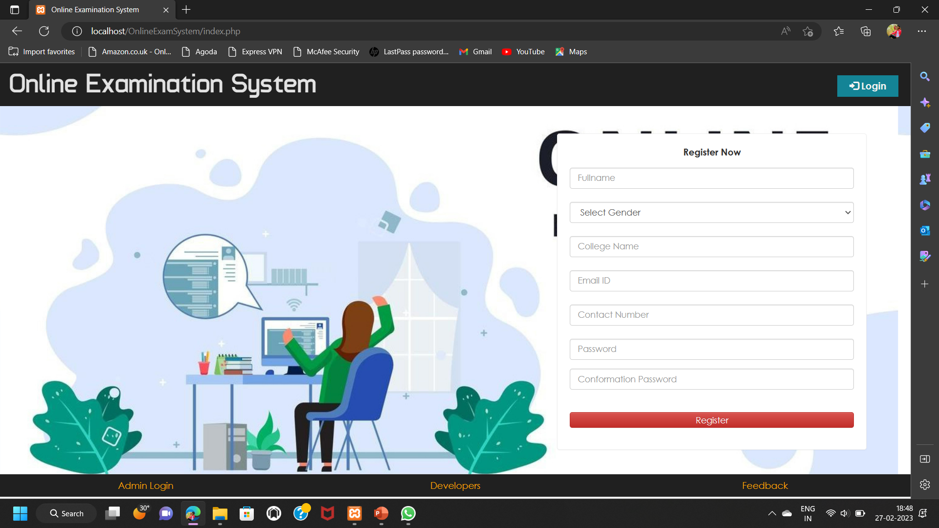
7. OUTPUT SCREENSHOT
Home page:-

Slide 12

Registration Page:-

Slide 13
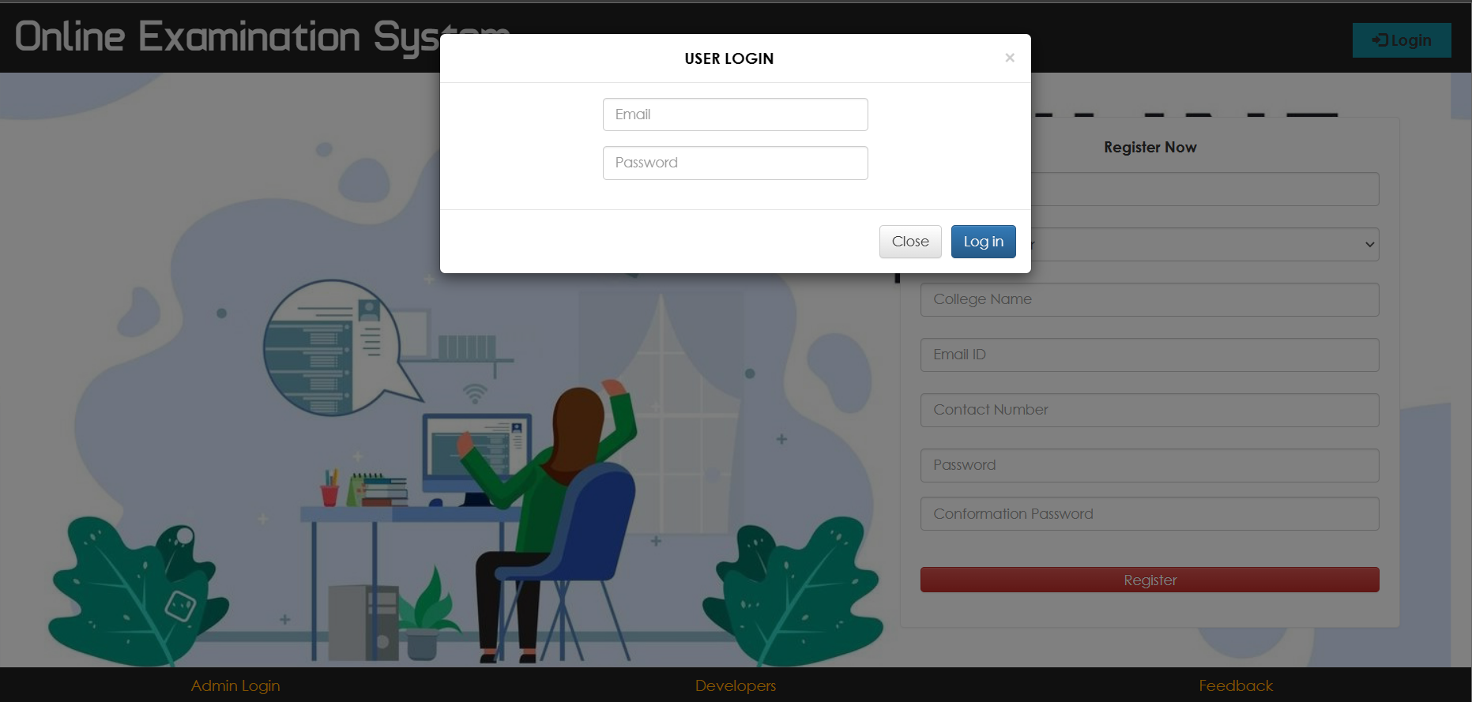
User Login Page:-

Slide 14
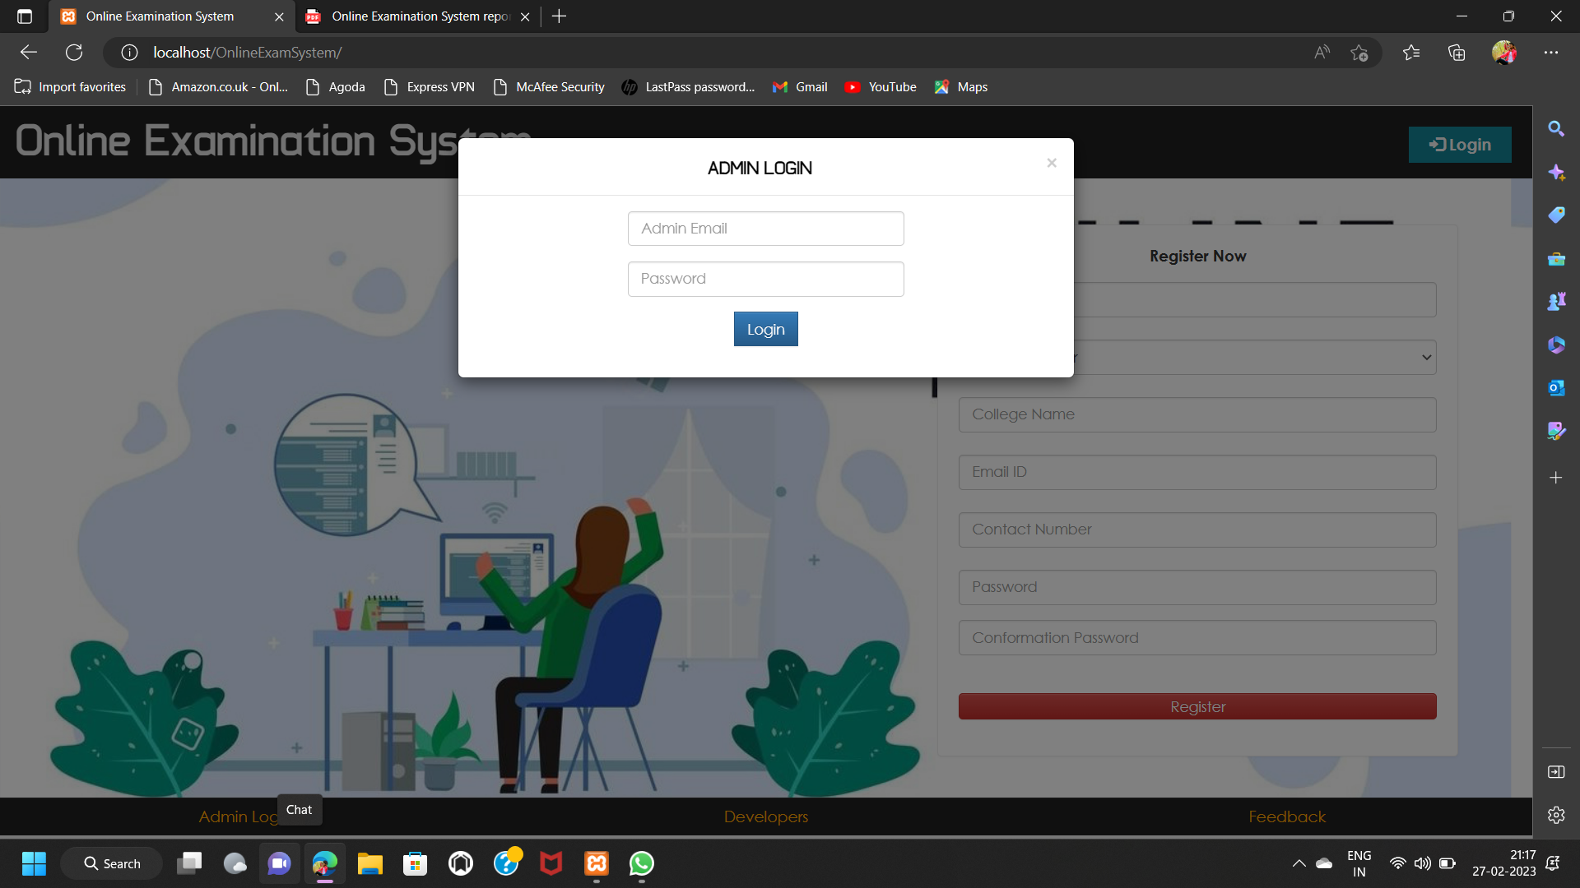
Admin Page:-

Slide 15
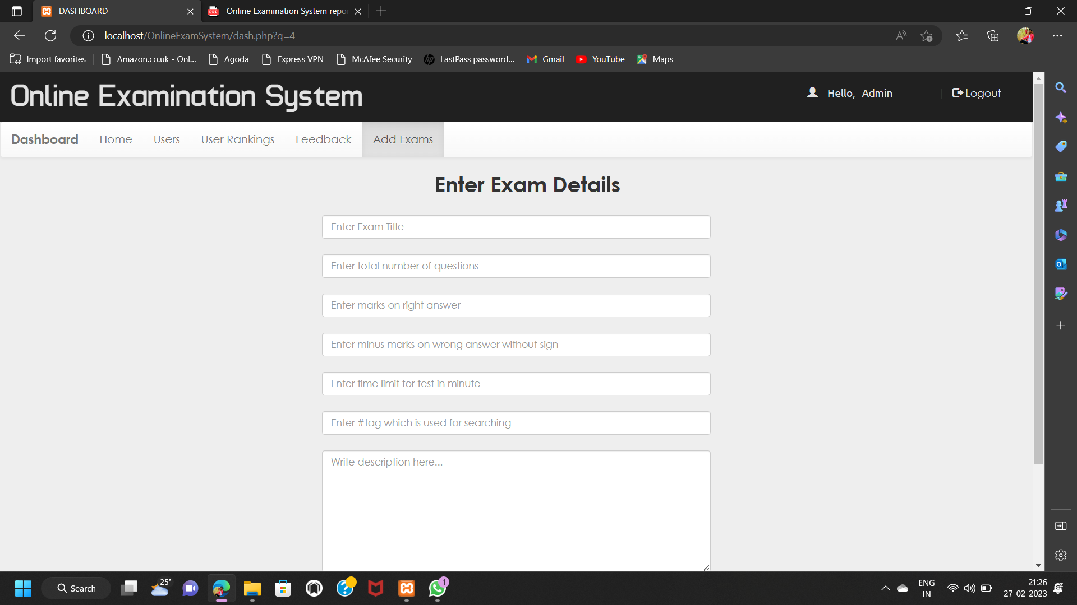
Add Exam Page:-

Slide 16
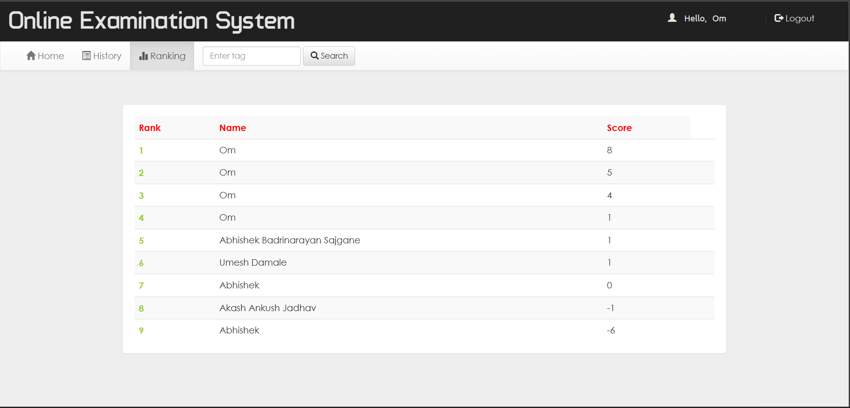
Ranking Page:-

Slide 17
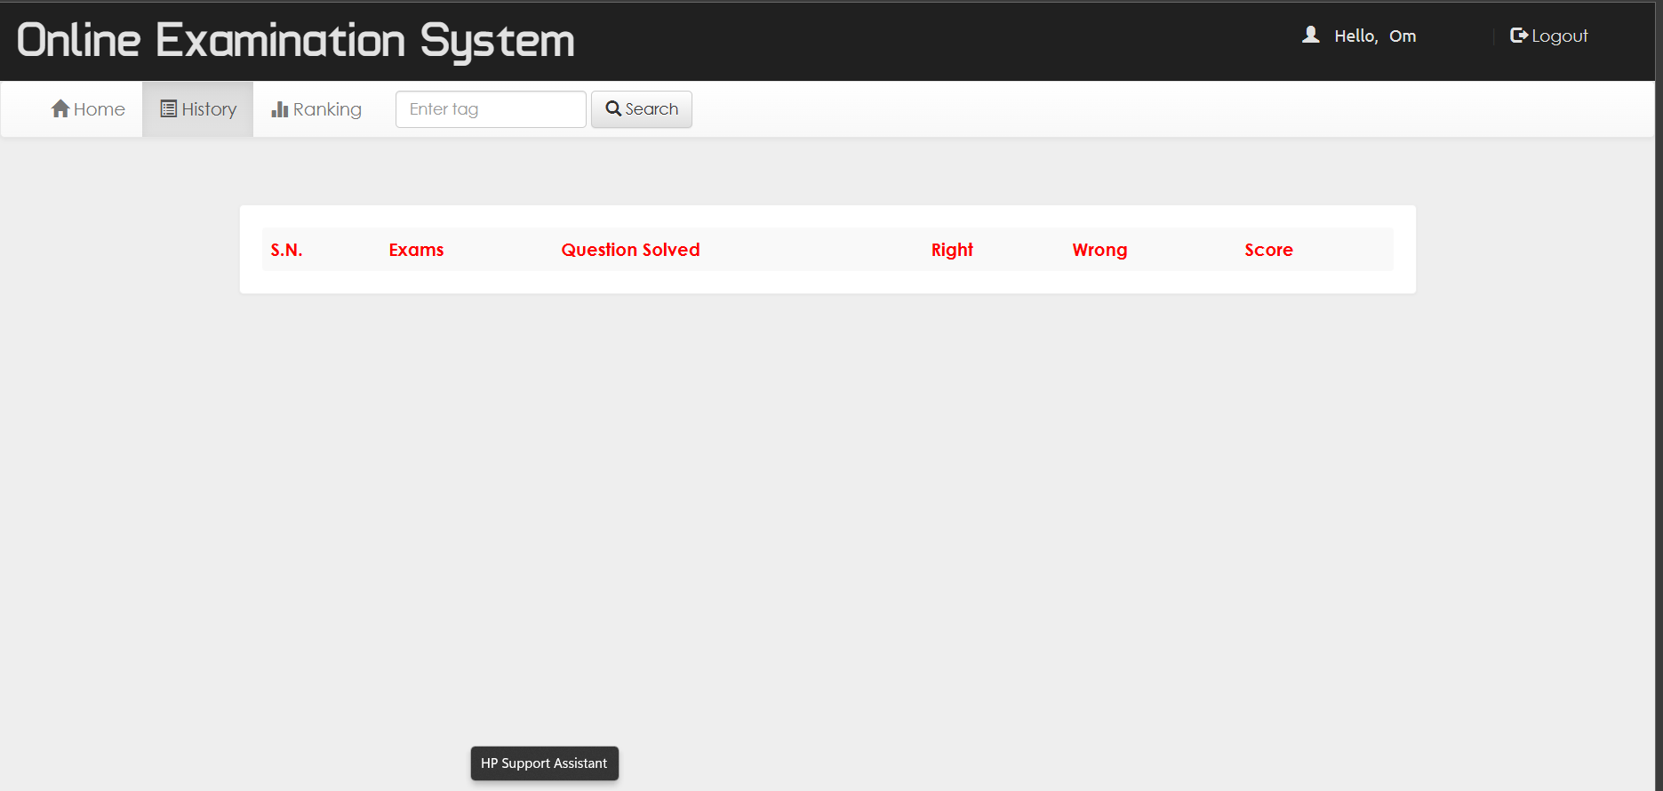
History Page:-

Slide 18
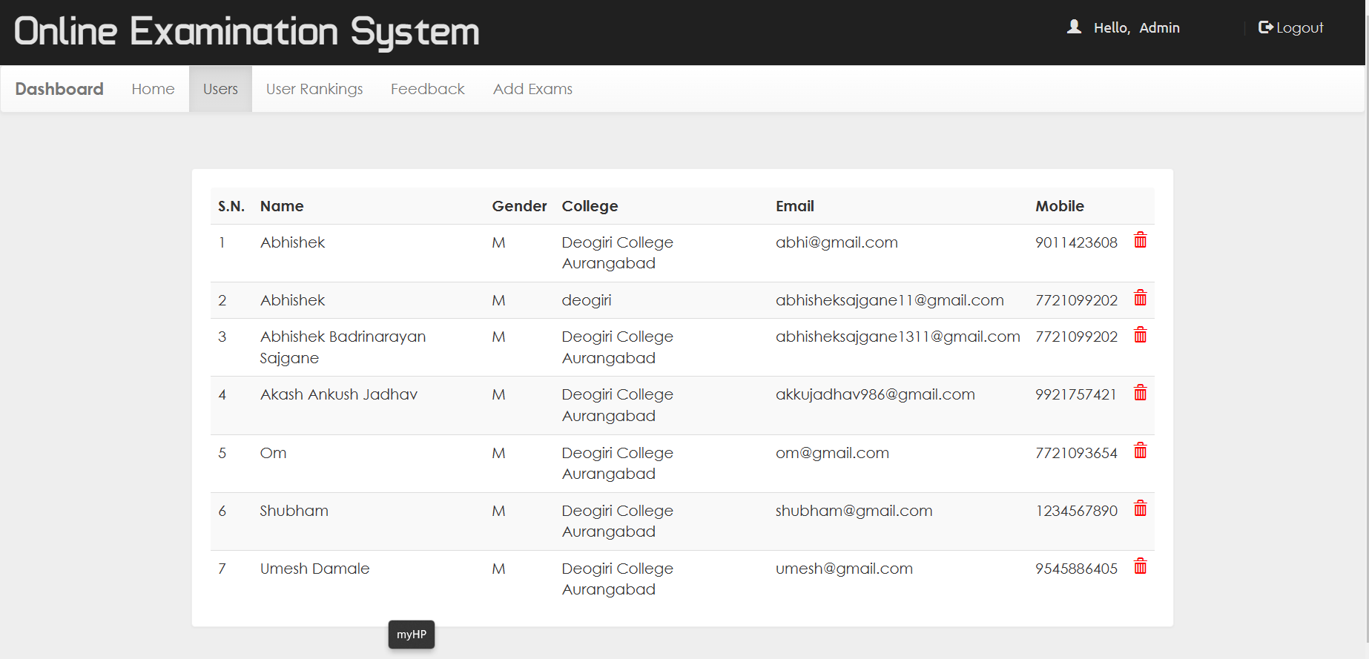
User Page:-

Slide 19
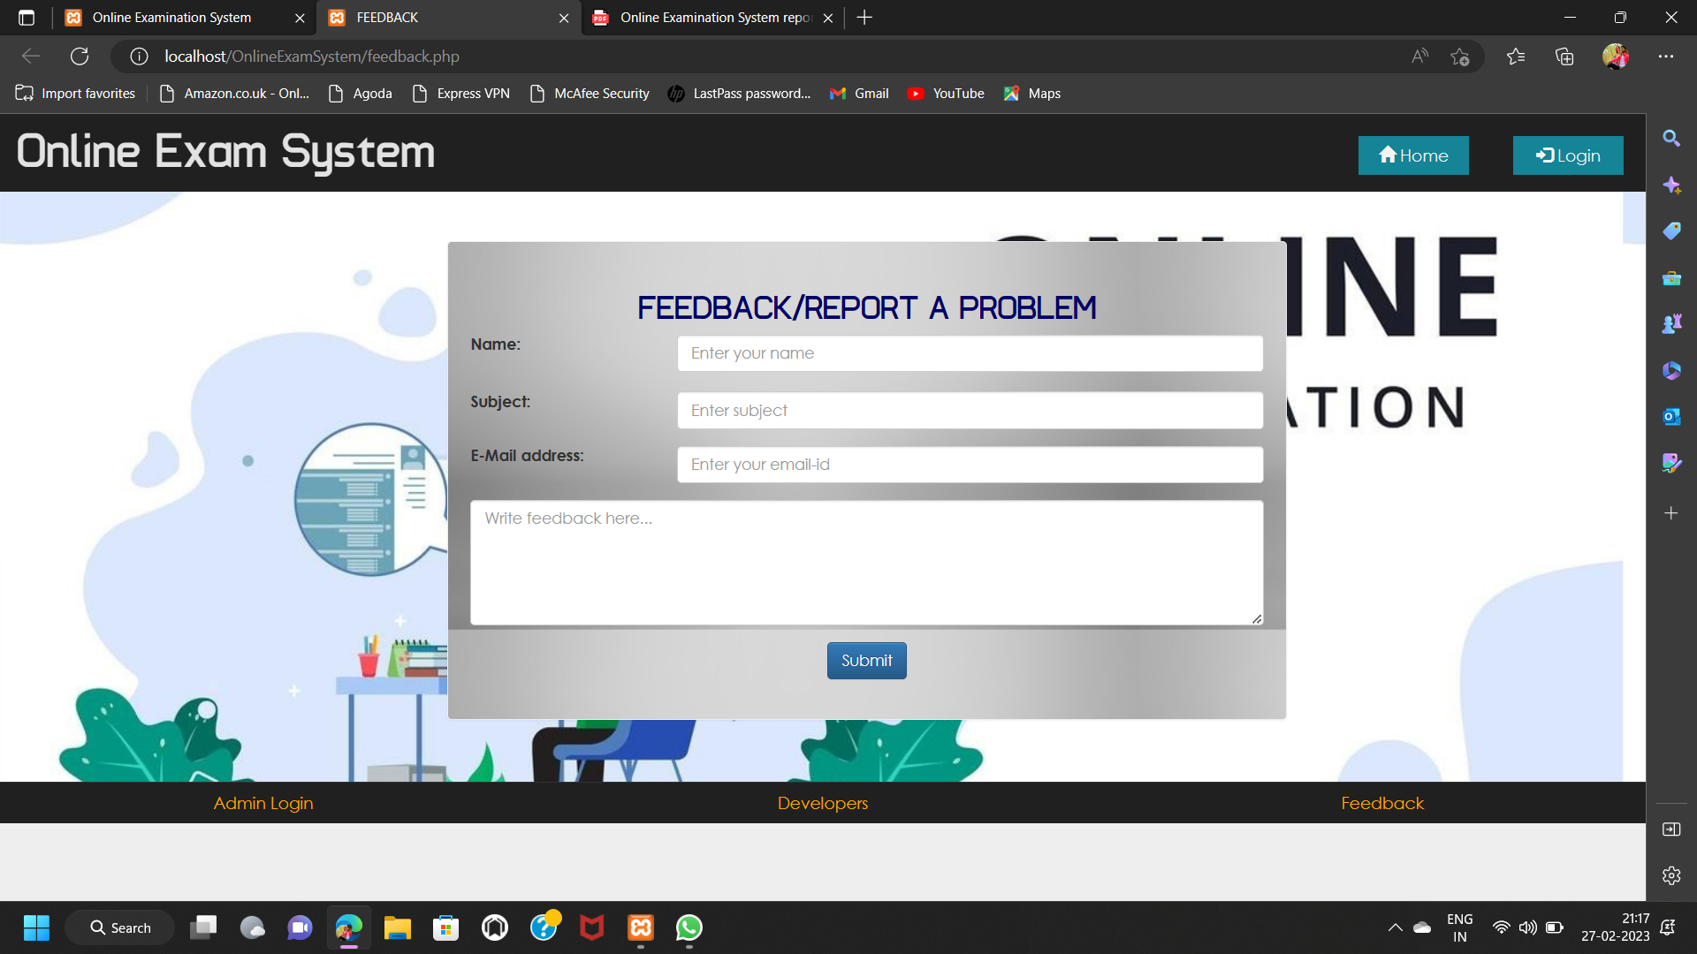
Feedback And Report Problem Page:-

Slide 20
8. CONCLUSION
In conclusion, online examination systems have revolutionized the way exams are conducted. These systems offer several advantages over traditional paper-based exams, including reduced administrative costs, increased efficiency, and enhanced security. Online examination systems can also be customized to meet the needs of different educational institutions and organizations. They allow for the creation of various types of questions, such as multiple-choice, short answer, and essay questions, and can even include multimedia elements like videos and images. However, online examination systems also face some challenges, such as technical glitches, connectivity issues, and concerns over cheating. It is essential to address these issues to ensure the integrity of the examination process. Overall, online examination systems offer a convenient and effective way to conduct exams, especially in today's digital age. With proper planning and implementation, these systems can enhance the learning and assessment experience for students and educators alike.

Slide 21
9. BIBLIOGRAPHY
HTML and CSS: Design and Build Websites-By Jon Docket
The Essential Guide to CSS and HTML Web Design (Essentials)-By Carignane
Smashing CSS: Professional Techniques for Modern Layout-By Eric Meyer
The Joy of PHP Programming: A Beginner’s Guide-By Alan Forbes
The Complete Beginner’s Guide to Learn PHP Programming-By Bruce Berke
New Features And Good Practices-By Josh Lockhart
PHP Advanced and Object-Oriented Programming: Visual QuickPro Guide-By Larry Ulman
SQL Queries for Mere Mortals-By John L. Viescas and Michael J. Hernandez
SQL Performance Tuning-y peter gulutzan
The Art of Sql-By Stephane Faroult
Learn JavaScript VISUALLY-By Ivelin Demirov

Slide 22
10. WEB REFERENCES
https://www.w3schools.com
https://www.geeksforgeeks.org
https://www.tutorialspoint.com
https://www.youtube.com
https://www.html-css-js.com
https://www.js-fiddle.net
www.wikipedia.org
www.youtube.com/webdevelopment

Slide 23
Any Question?

Slide 24
THANK YOU…!

